Slide 1
18MAB102T- ADVANCED CALCULUS AND COMPLEX ANALYSIS
UNIT- IV
ANALYTIC FUNCTIONS

Slide 2
Contents
  Definition of Analytical Function
  Cauchy Riemann Equations
  Properties of analytical functions
  Determination of Harmonic Conjugate
  Milne-Thomson’s method
  Conformal mappings : 1/z , az , az+b .
  Bilinear Transformation

Slide 3
Analytical functions :- ( Regular functions or Holomorphic functions)
DEFINITION:-
A SINGLE VALUED FUNCTION F(Z) IS SAID TO BE ANALYTIC AT A POINT Z₀ ,IF IT HAS A DERIVATIVE AT Z₀ AND AT EVERY POINT IN SOME NEIGHBOURHOOD OF Z₀ .
NOTE :
IF IT IS ANALYTICAL AT EVERY POINT IN A REGION R, THEN IT IS SAID TO BE ANALYTIC IN THE REGION R.

Slide 4
Necessary condition for a complex function f(z) to be analytic:-
Derivation of Cauchy-Riemann equations:-
STATEMENT:-
IF F(Z) = U(X,Y) + I V(X,Y) IS ANALYTIC IN A REGION R OF THE Z-PLANE THEN
I) U_{X} , U_{Y}, V_{X} , V_{Y} EXIST AND
II) U_{X} = V_{Y} AND U_{Y} = -V_{X} AT EVERY POINT IN THAT REGION.

Slide 5
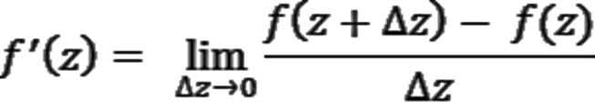
Necessary condition for a complex function f(z) to be analytic:-
Derivation of Cauchy-Riemann equations:-
PROOF:-
LET F(Z) = U(X,Y) + I V(X,Y)
WE FIRST ASSUME F(Z) IS ANALYTIC IN A REGION R. THEN BY THE
DEFINITION, F(Z) HAS A DERIVATIVE F’(Z) EVERYWHERE IN R.
NOW

Slide 6

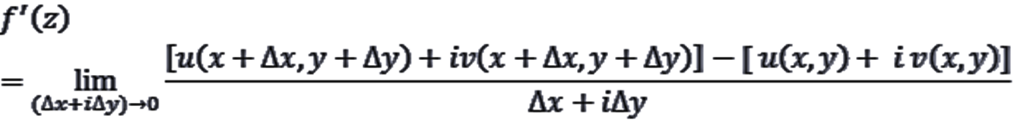
Derivation of Cauchy-Riemann equations:-
LET Z = X+IY
ΔZ = ΔX + I ΔY
( Z+ΔZ) = (X+ΔX) + I (Y+ΔY)
WE KNOW THAT, F(Z) = U(X,Y) + I V(X,Y)
NOW

Slide 7
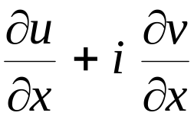
Derivation of Cauchy-Riemann equations:-
CASE (I) :- IF ΔZ→0 , FIRST WE ASSUME THAT ΔY=0 AND ΔX→0
∴
=
∴ F’(Z) = U_{X}+ I V_{X} -------→(1)

Slide 8
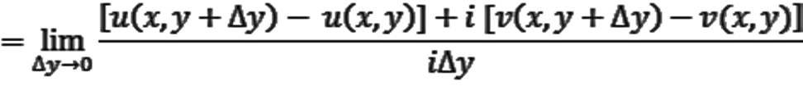
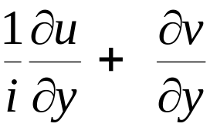
Derivation of Cauchy-Riemann equations:-
CASE (II) :- IF ΔZ→0 , NOW WE ASSUME ΔX=0 AND ΔY→0
∴
=
∴ F’(Z) = -I U_{Y}+ V_{Y} -------→(2) (SINCE 1/I = -I)

Slide 9
Derivation of Cauchy-Riemann equations:-
FROM (1) & (2) , WE GET
U_{X} + I V_{X =} -I U_{Y}+ V_{Y}
EQUATING REAL AND IMAGINARY PARTS WEGET,
U_{X} = V_{Y} AND U_{Y} = - V_{X}
THE ABOVE EQUATIONS ARE CALLED CAUCHY-RIEMANN EQUATIONS (OR) C-R EQUATIONS .
THEREFORE THE FUNCTION F(Z) TO BE ANALYTIC AT THE POINT Z, IT IS NECESSARY THAT THE FOUR PARTIAL DERIVATIVES U_{X} , U_{Y,} V_{X,} V_{Y} SHOULD EXIST AND SATISFY THE C-R EQUATIONS.

Slide 10
Sufficient condition for f(z) to be analytic
STATEMENT:- THE SINGLED VALUED CONTINUOUS FUNCTION F(Z) = U + I V IS ANALYTIC IN A REGION R OF THE Z-PLANE, IF THE FOUR PARTIAL DERIVATIVES U_{X} , U_{Y} , V_{X} , V_{Y} , (I) EXIST , (II) CONTINUOUS , (III) THEY SATISFY THE C-R EQUATIONS U_{X} = V_{Y} AND U_{Y} = - V_{X} AT EVERY POINT OF R.
NOTE:- ALL POLYNOMIALS, TRIGONOMETRIC, EXPONENTIAL FUNCTIONS ARE CONTINUOUS.

Slide 11
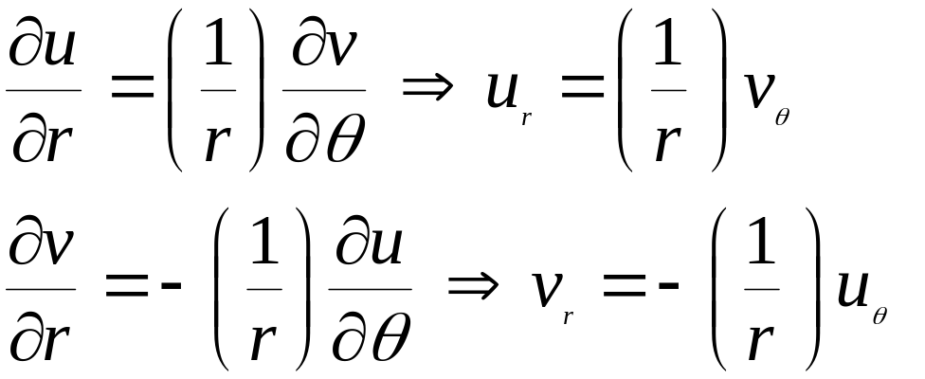
Cauchy-Riemann Equations in Polar form
STATEMENT:- IF F(Z) = U(R,Θ) + I V(R,Θ) IS DIFFERENTIAL AR Z = RE^{IΘ} , THEN
PROOF:- LET Z = RE^{IΘ}
AND F(Z) = U+IV
I.E., U+IV = F( RE^{IΘ} ) (1)

Slide 12
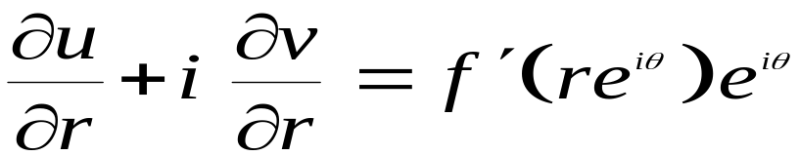
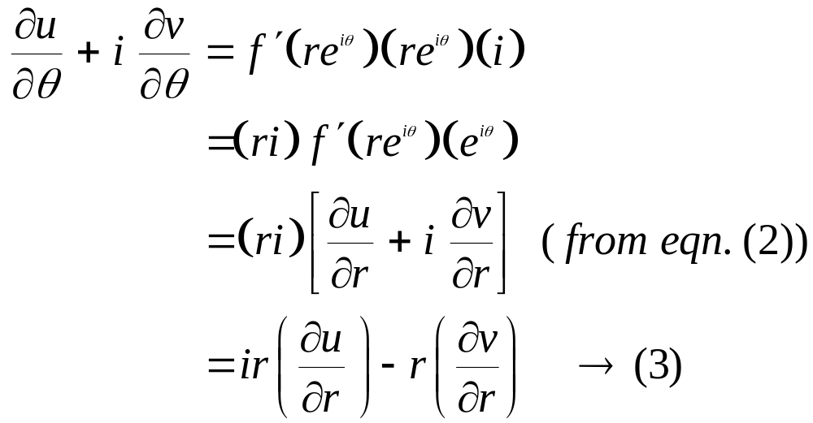
Cauchy-Riemann Equations in Polar form
DIFFERENTIATING PARTIALLY W.R.T. ̀R ́ WEGET,
(2)
DIFFERENTIATING PARTIALLY W.R.T. ̀Θ ́ WEGET,

Slide 13
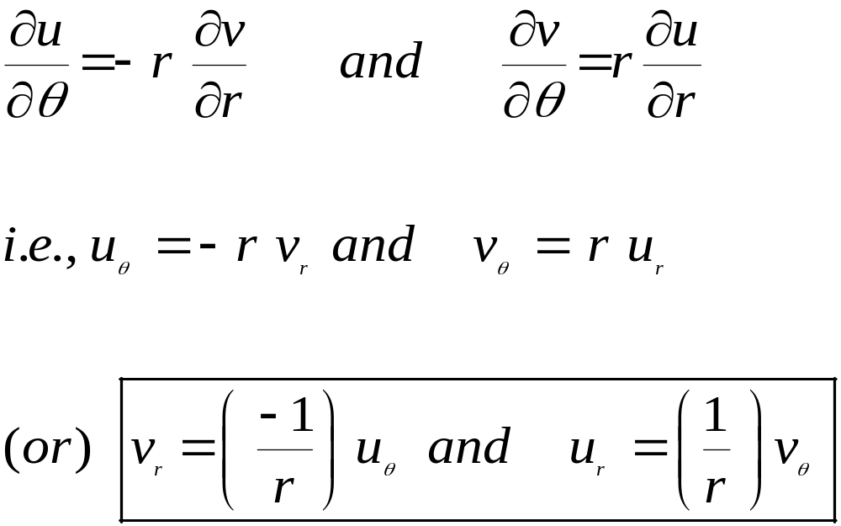
Cauchy-Riemann Equations in Polar form
EQUATING REAL AND IMAGINARY PARTS IN EQN. (3) , WEGET,

Slide 14
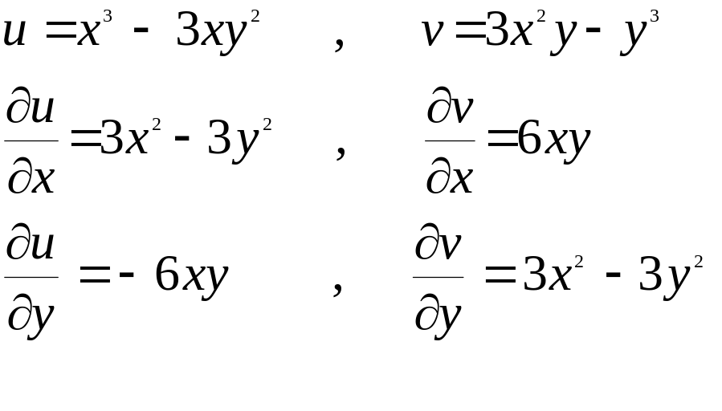
EXAMPLES
1) SHOW THAT F(Z) = Z³ IS ANALYTIC.
PROOF:- GIVEN F(Z) = Z³ =(X+IY)³ = X ³ + 3 X ²(IY) + 3X(IY)² + (IY)³
= (X ³ - 3XY²) + I ( 3X²Y – Y³ )
WE KNOW THAT F(Z) = U+IV
SO ,

Slide 15
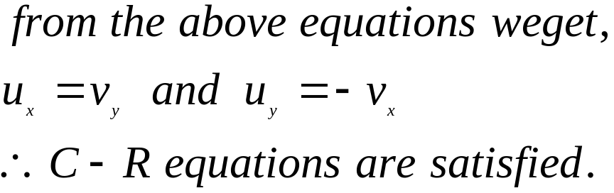
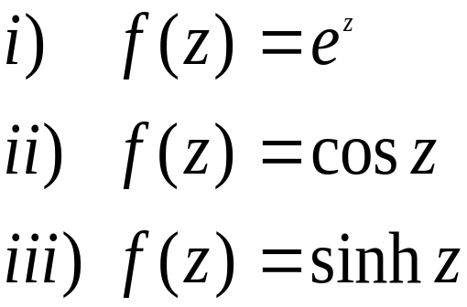
EXAMPLES
HERE U_{X} , U_{Y} , V_{X} , V_{Y} EXISTS AND CONTINUOUS.
HENCE THE GIVEN FUNCTION F(Z) IS ANALYTIC.
EXAMINE THE ANALYTICITY OF THE FOLLOWING FUNCTIONS AND FIND ITS DERIVATIVES.

Slide 16
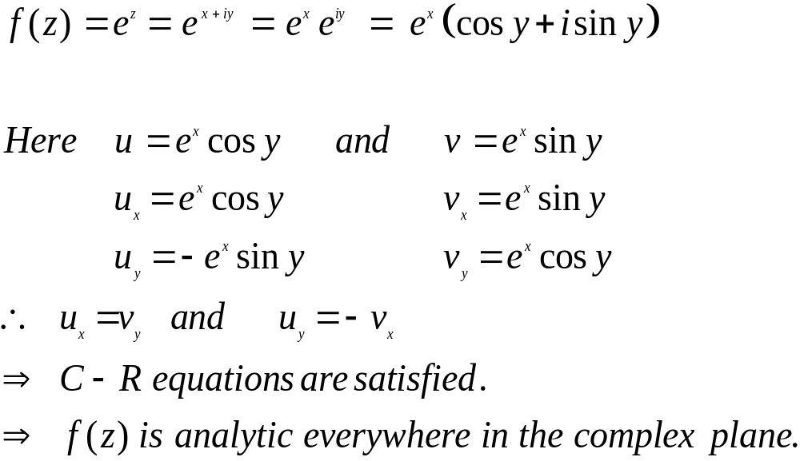
EXAMPLES
I) SOLUTION:-

Slide 17
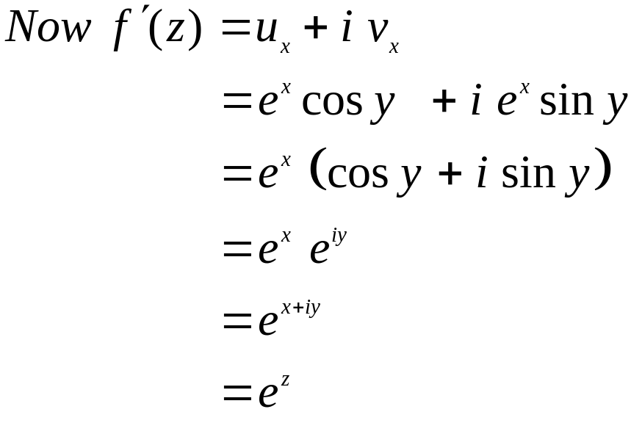
EXAMPLES

Slide 18
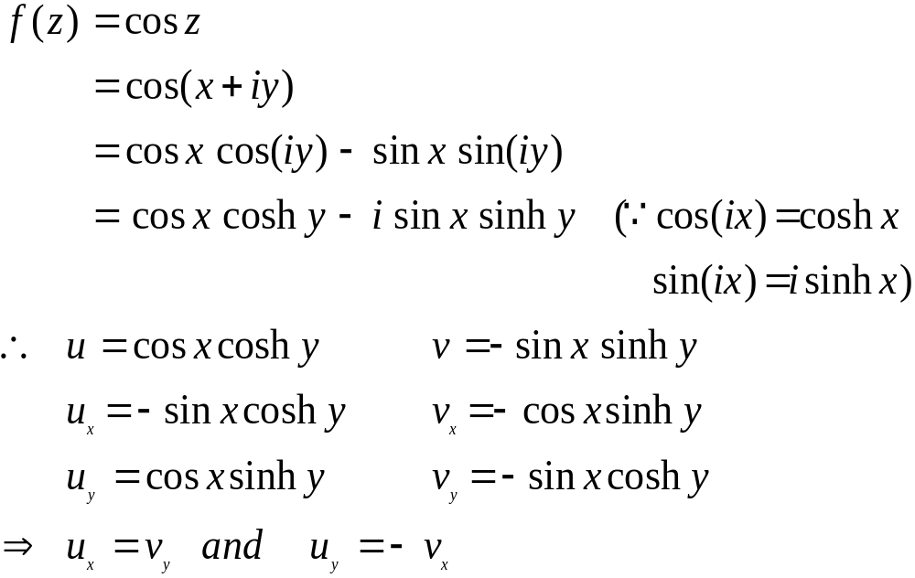
EXAMPLES
II) SOLUTION:-

Slide 19
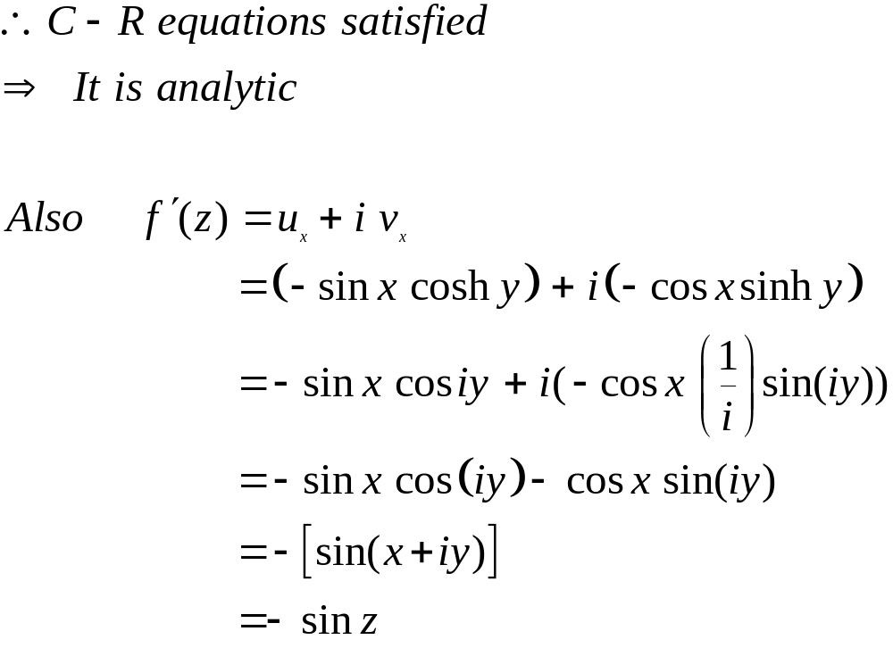
EXAMPLES

Slide 20
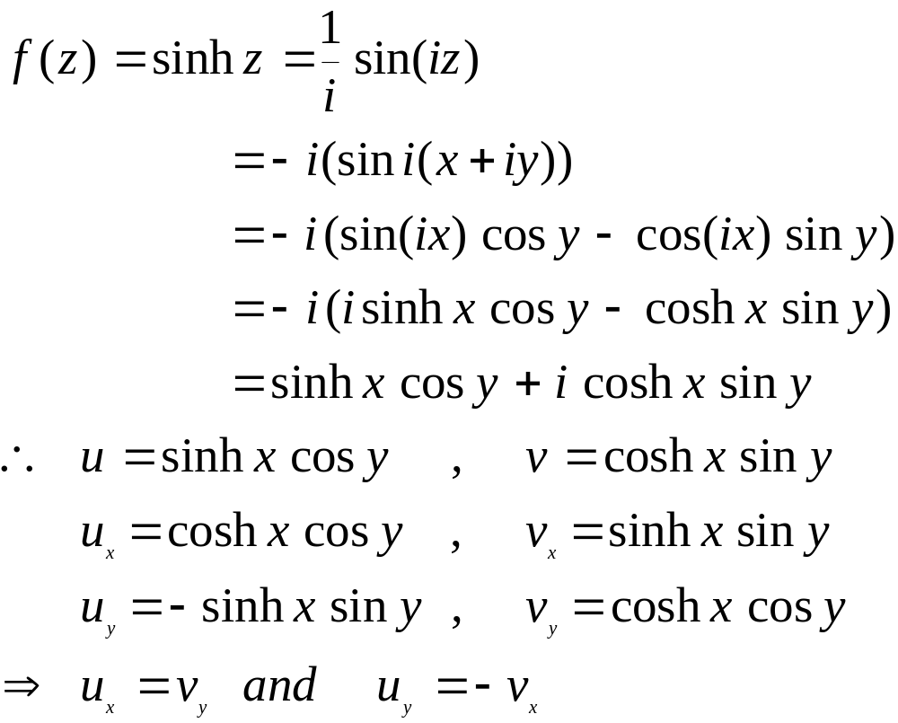
EXAMPLES
SOLUTION:-

Slide 21
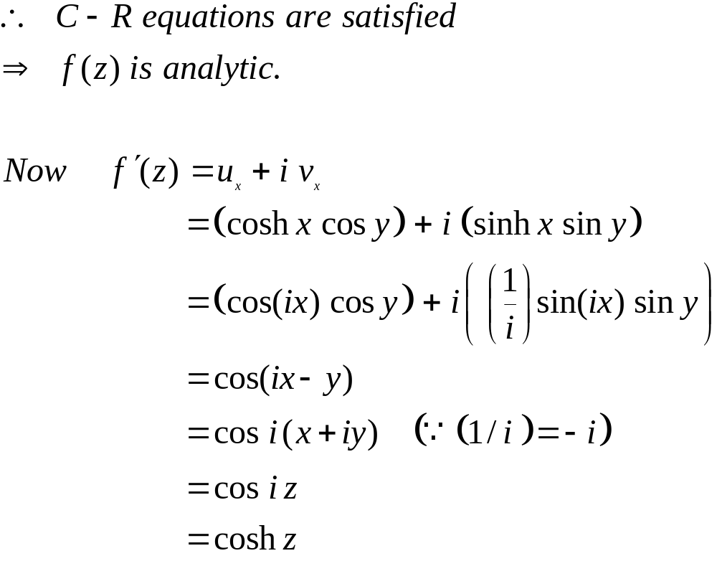
EXAMPLES

Slide 22
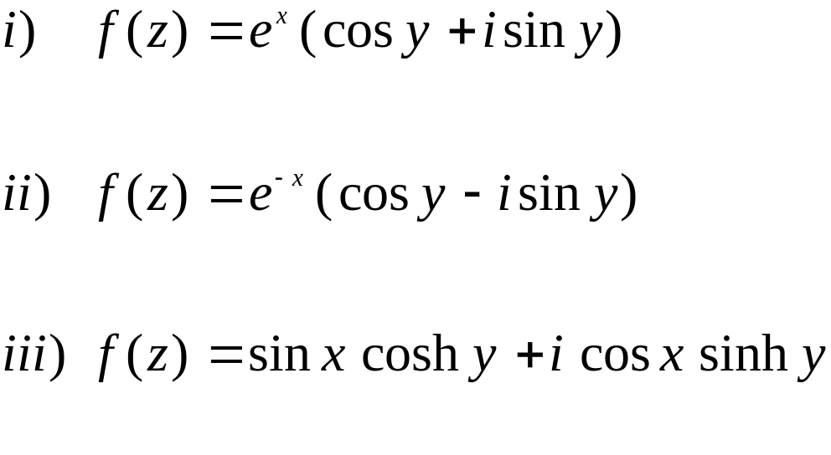
TRY IT
EXAMINE THE ANALYTICITY OF THE FOLLOWING FUNCTIONS AND FIND ITS DERIVATIVES.

Slide 23
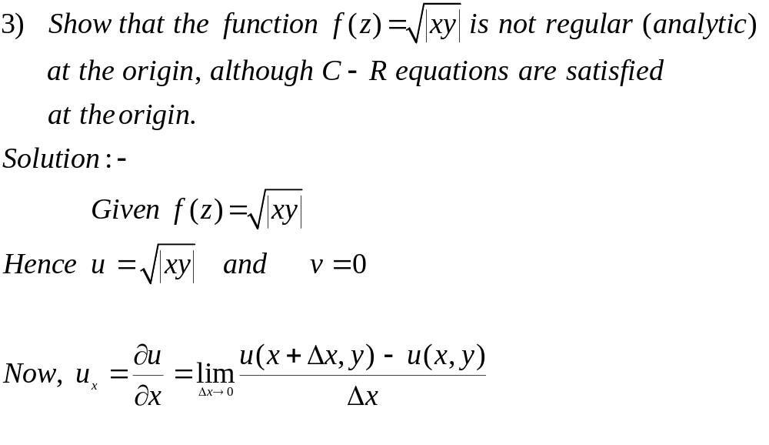
EXAMPLES

Slide 24
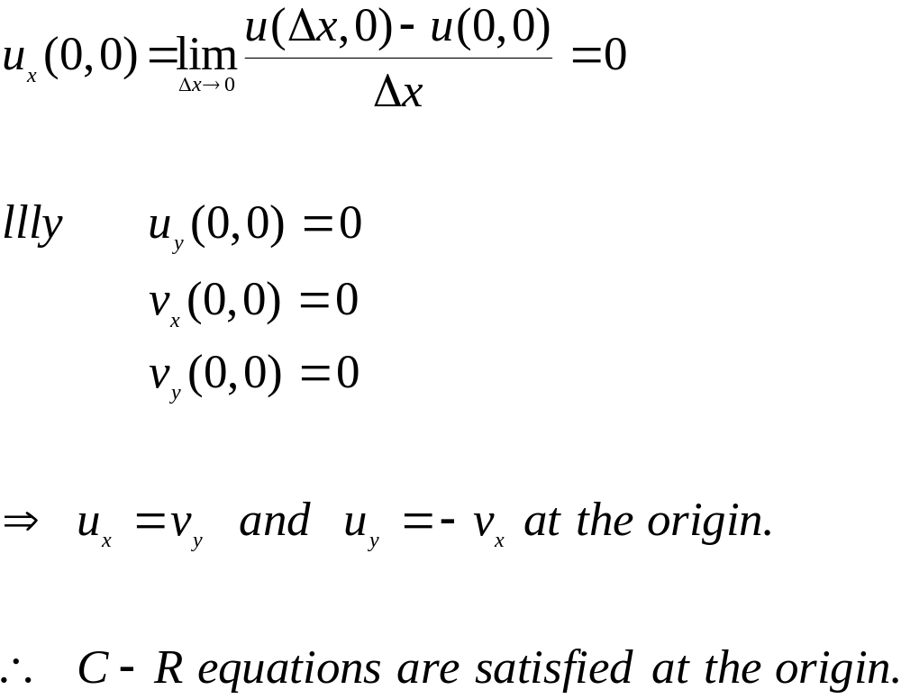
EXAMPLES

Slide 25
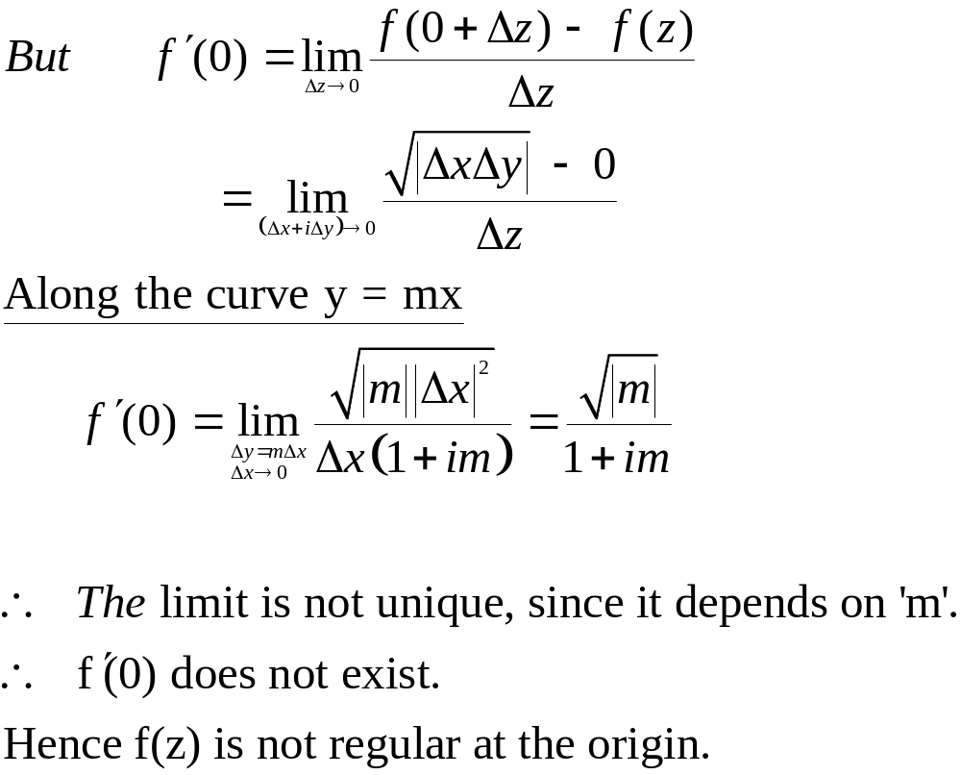
EXAMPLES

Slide 26
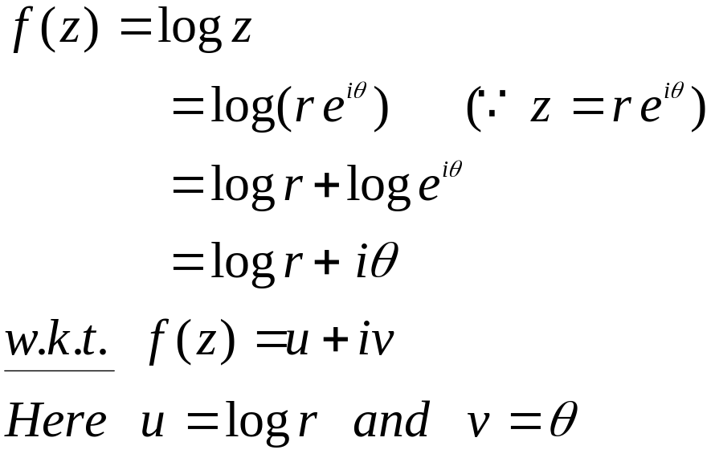
C-R equations in polar form
EXAMPLES
1) CHECK FOR ANALYTICITY OF LOGZ
(OR) SHOW THAT F(Z) = LOGZ IS ANALYTIC EVERYWHERE EXCEPT AT THE ORIGIN AND FIND ITS DERIVATIVES.
SOLUTION:-

Slide 27
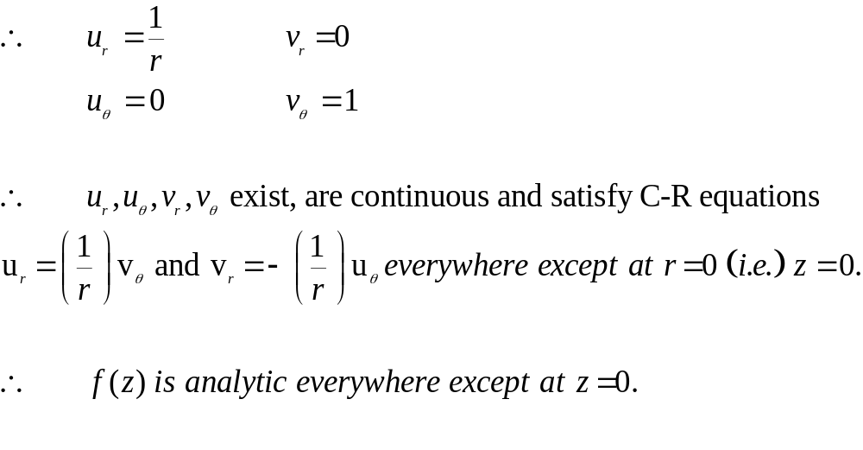
EXAMPLES

Slide 28
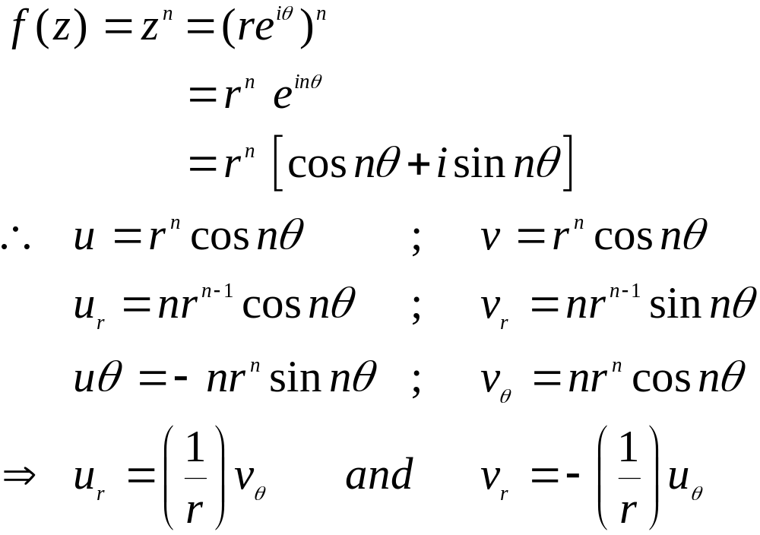
EXAMPLES
PROVE THAT F(Z) = Z^{N} IS ANALYTIC FUNCTION AND FIND ITS DERIVATIVES.
PROOF:-

Slide 29
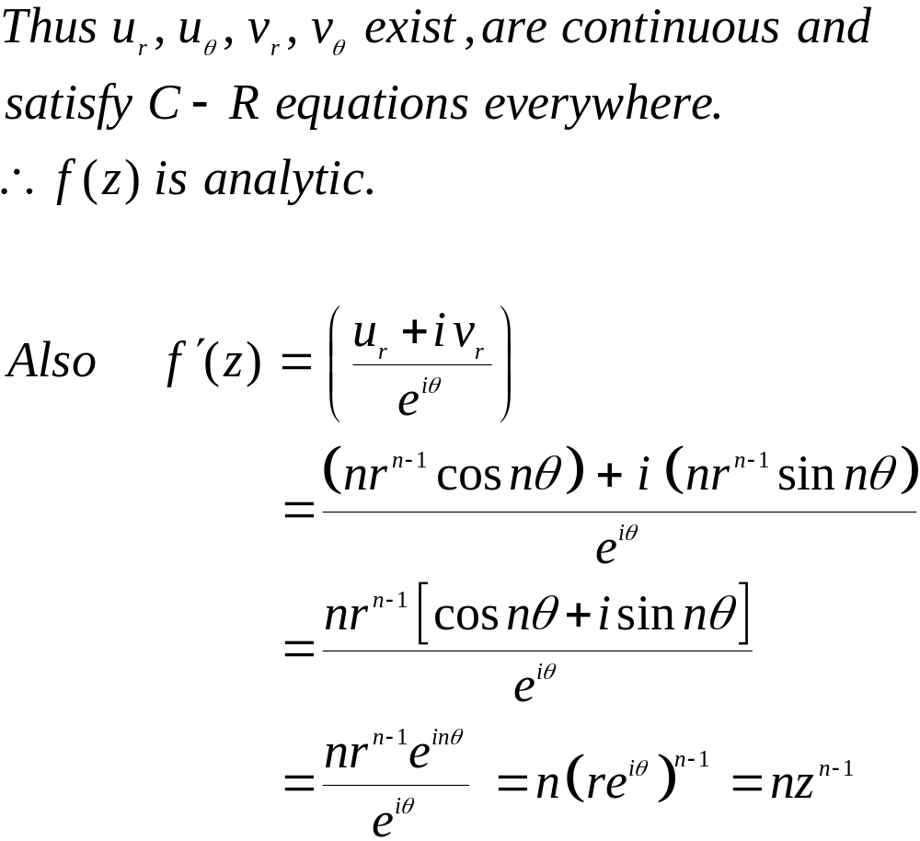
EXAMPLES

Slide 30
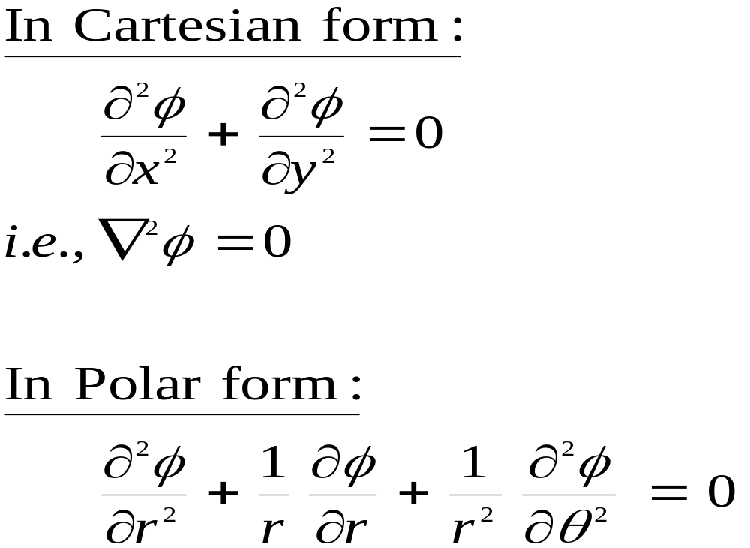
Laplace Equations

Slide 31
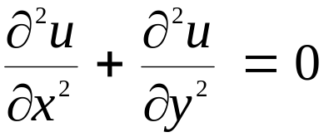
HARMONIC FUNCTIONS
A REAL VALUED FUNCTION OF TWO REAL VARIABLES X AND Y IS SAID TO BE HARMONIC, IF
THE SECOND ORDER PARTIAL DERIVATIVES U_{XX} , U_{XY} , U_{YX} , U_{YY} EXIST AND THEY ARE CONTINUOUS.
AND
THE LAPLACE EQUATION SATISFIES.
CONJUGATE HARMONIC FUNCTIONS:-
IF U+IV IS AN ANALYTIC FUNCTION OF Z THEN V IS CALLED A CONJUGATE HARMONIC FUNCTION OF U; (OR) U IS CALLED A CONJUGATE HARMONIC FUNCTION OF V; (OR) U AND V ARE CALLED CONJUGATE HARMONIC FUNCTIONS.

Slide 32
Properties of Analytic functions
PROPERTY (1) :- THE REAL AND IMAGINARY PARTS OF AN ANALYTIC FUNCTION F(Z) = U+IV SATISFY THE LAPLACE EQUATION (OR) REAL PART “U” AND IMAGINARY PART “V” OF AN ANALYTIC FUNCTION F(Z) = U+IV ARE HARMONIC FUNCTIONS.
PROOF:-
GIVEN F(Z) = U+I V IS AN ANALYTIC FUNCTION.
I.E., U AND V ARE CONTINUOUS, U_{X} , U_{Y} , V_{X} , V_{Y} ARE EXIST AND THEY SATISFY THE C-R EQUATIONS U_{X} = V_{Y} AND U_{Y} = - V_{X}
(1) (2)

Slide 33
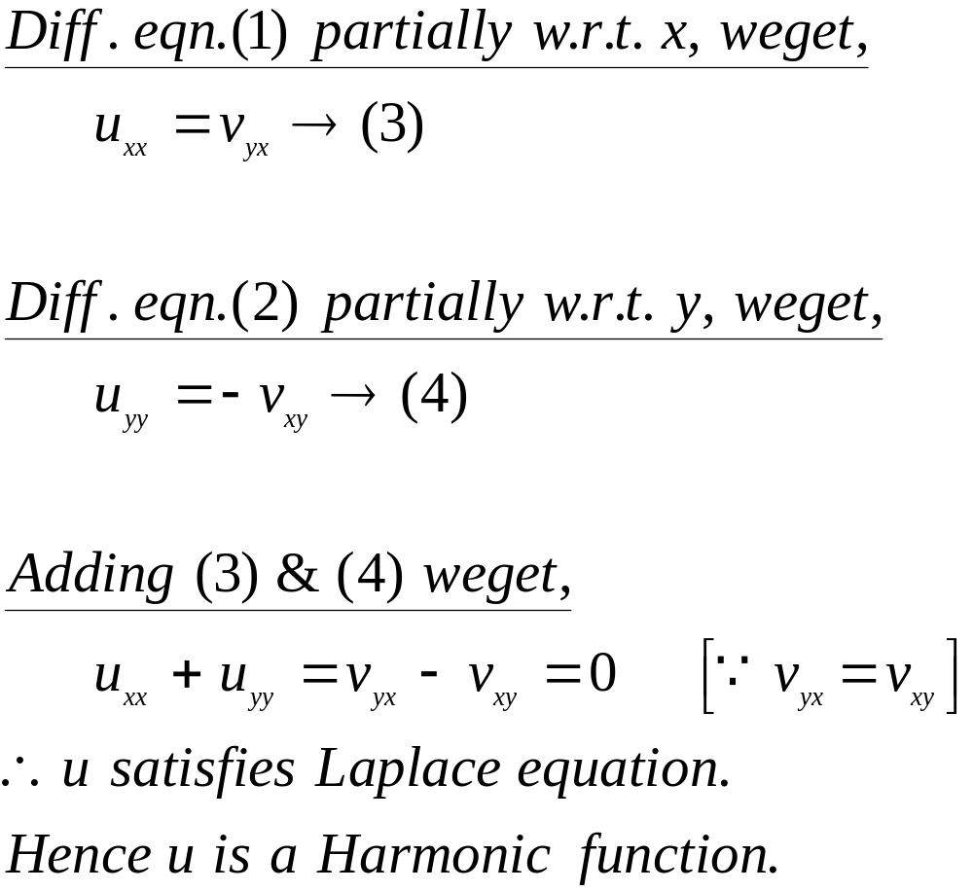
Properties of Analytic functions

Slide 34
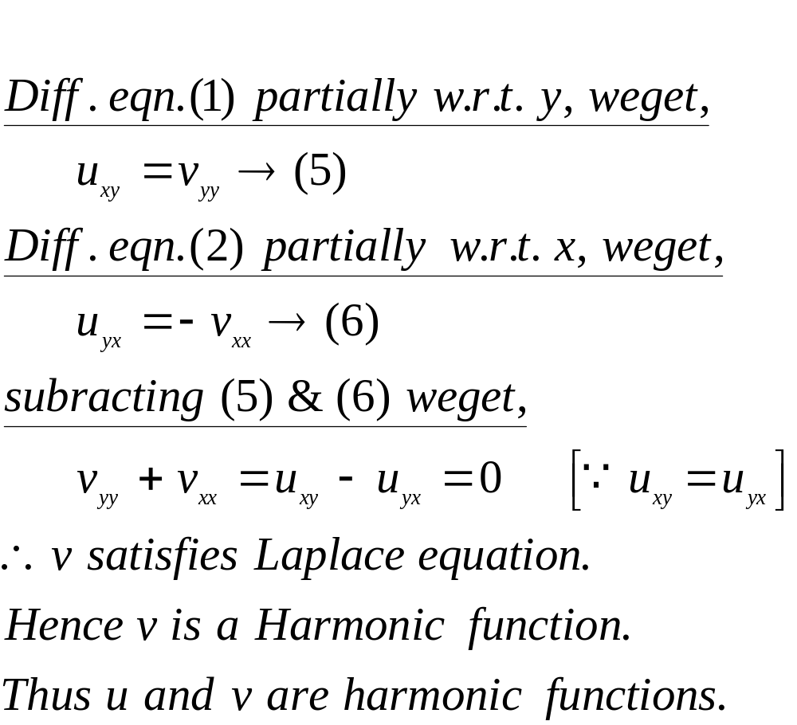
Properties of Analytic functions
NOW ,
NOTE:- THE CONVERSE OF THE ABOVE RESULT NEED NOT BE TRUE.

Slide 35
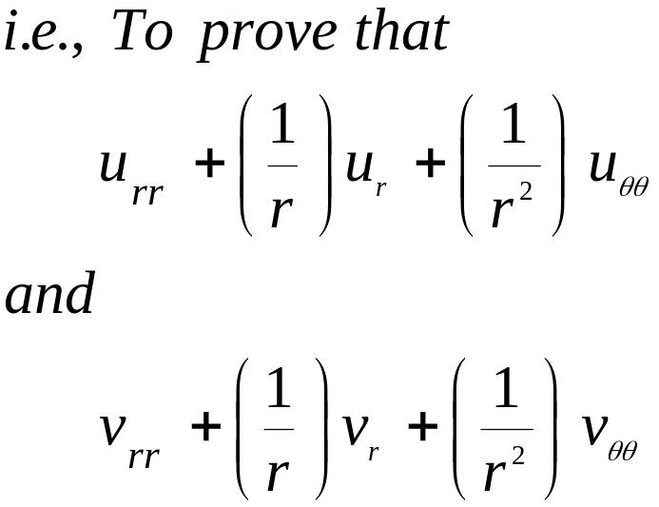
Properties of Analytic functions
TRY IT
PROVE THAT THE REAL AND IMAGINARY PARTS OF AN ANALYTIC FUNCTION F(Z) = U(R,Θ) + I V(R, Θ) SATISFY THE LAPLACE EQUATION IN POLAR COORDINATES.

Slide 36
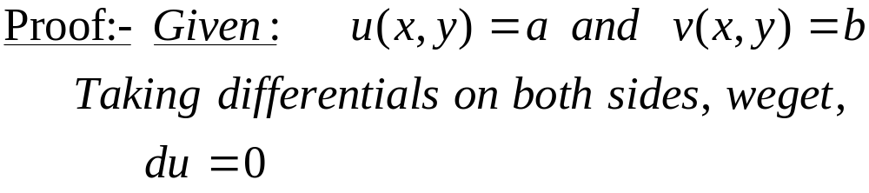
Properties of Analytic functions
ORTHOGONAL CURVES:-
TWO CURVES ARE SAID TO BE ORTHOGONAL TO EACH OTHER THEN THEY INTERSECT AT RIGHT ANGLES. [ PRODUCT OF SLOPES M₁ M₂ = -1]
PROPERTY (2) :-
IF F(Z) = U+ IV IS AN ANALYTIC FUNCTION THEN THE FAMILY OF CURVES
U(X,Y) = A AND V(X,Y) = B (WHERE A&B ARE CONSTANTS) CUT EACH OTHER ORTHOGONALLY.

Slide 37
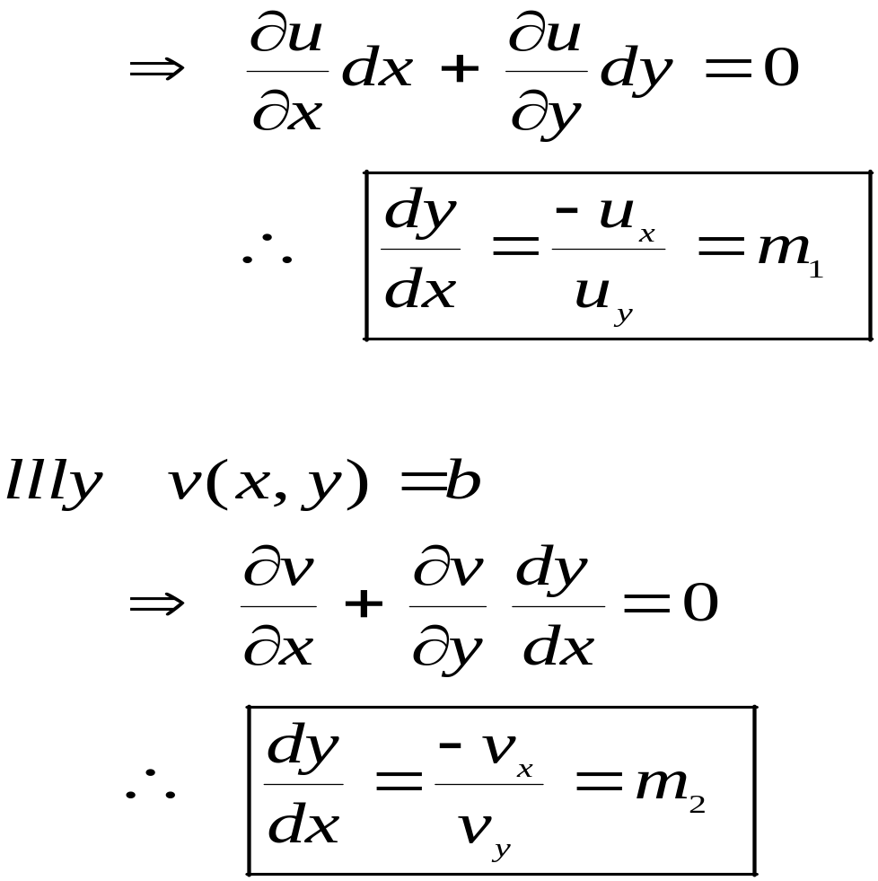
Properties of Analytic functions

Slide 38
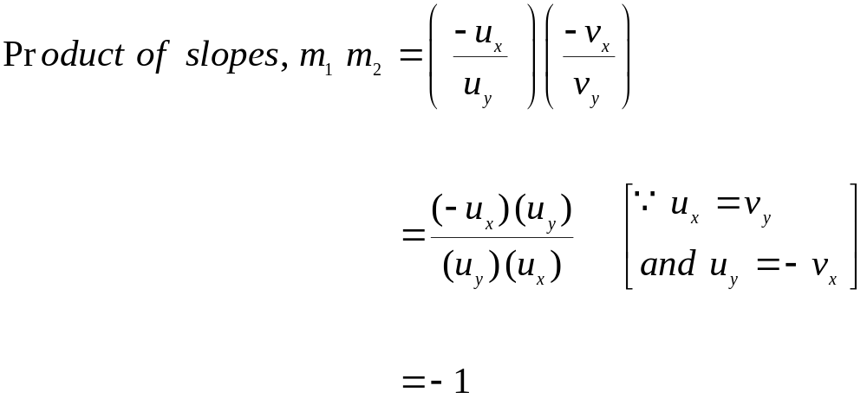
Properties of Analytic functions
HENCE THE TWO CURVES IN EQNS. (3) & (4) ARE ORTHOGONAL CURVES.

Slide 39
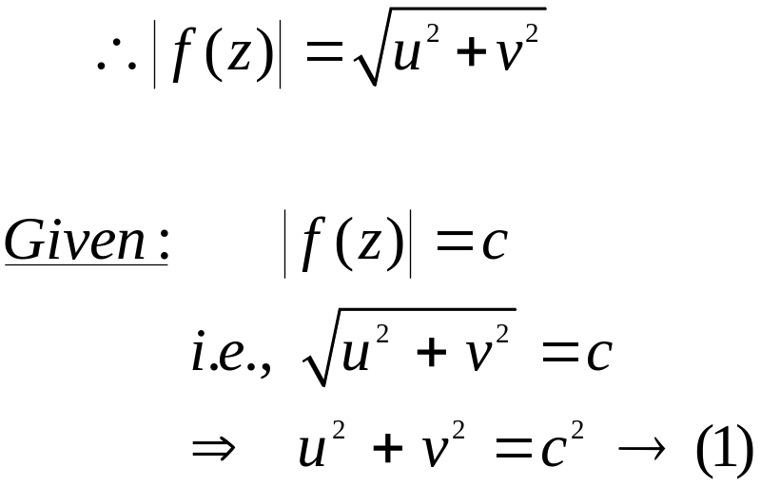
Properties of Analytic functions
RESULT :- (1) AN ANALYTIC FUNCTION WITH CONSTANT MODULUS IS CONSTANT.
PROOF:-
LET F(Z) = U + I V BE AN ANALYTIC FUNCTION

Slide 40
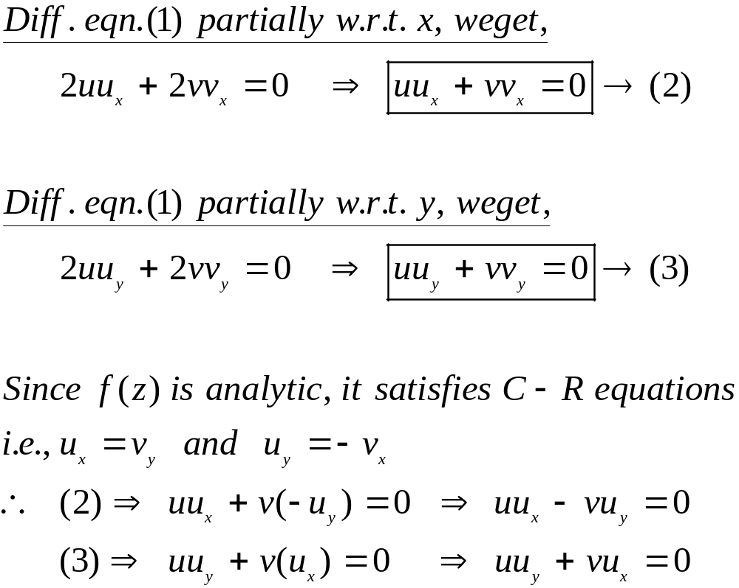
Properties of Analytic functions

Slide 41
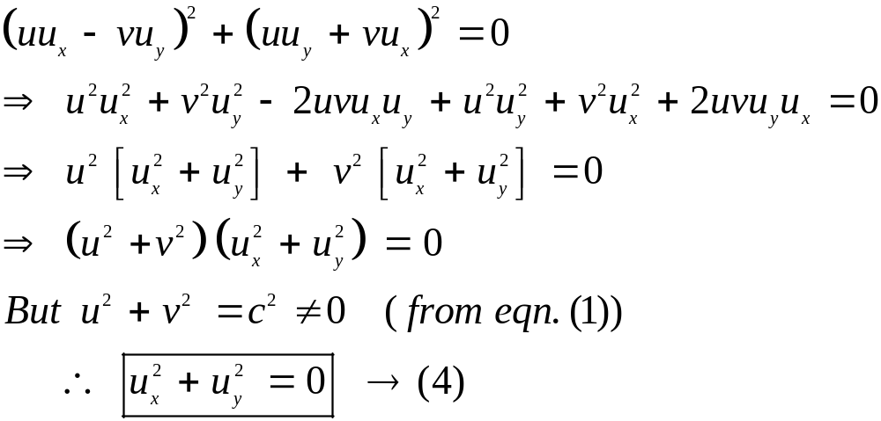
Properties of Analytic functions
SQUARING AND ADDING THE ABOVE EQUATIONS, WEGET,

Slide 42
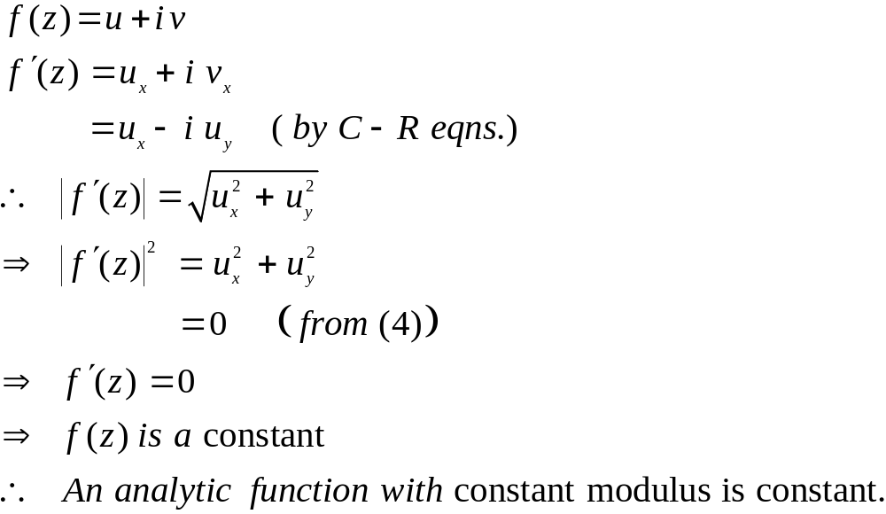
Properties of Analytic functions
SINCE

Slide 43

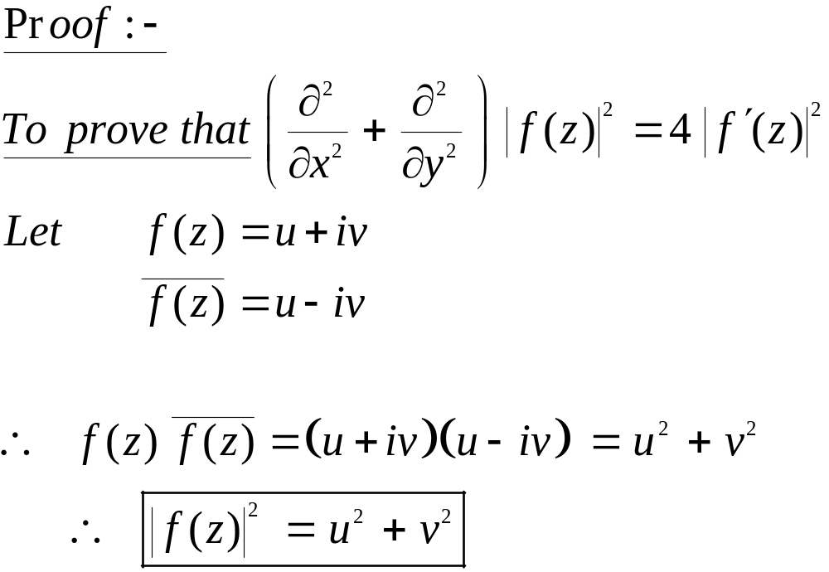
Properties of Analytic functions
RESULT :- (2) IF F(Z) = U+IV IS A REGULAR FUNCTION OF Z = X+IY THEN

Slide 44
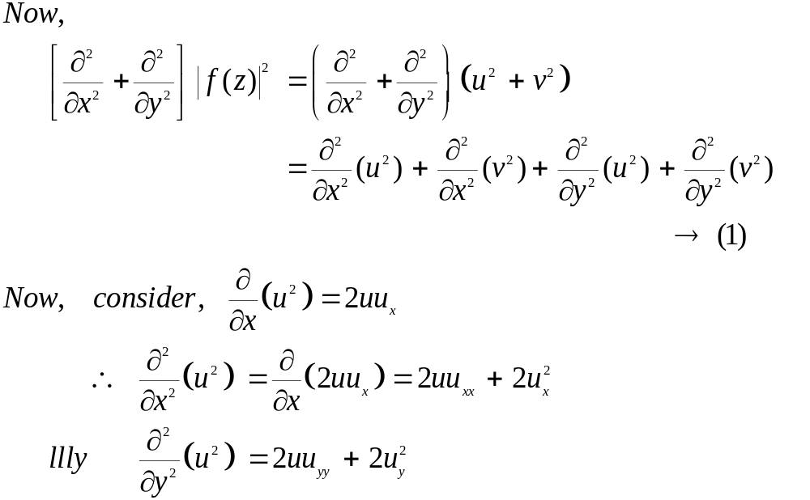
Properties of Analytic functions

Slide 45
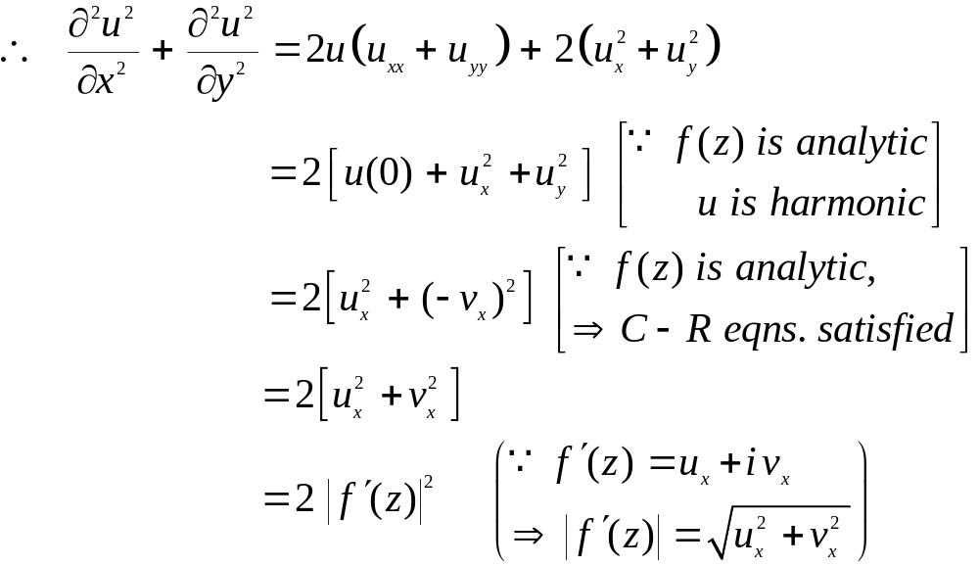
Properties of Analytic functions

Slide 46
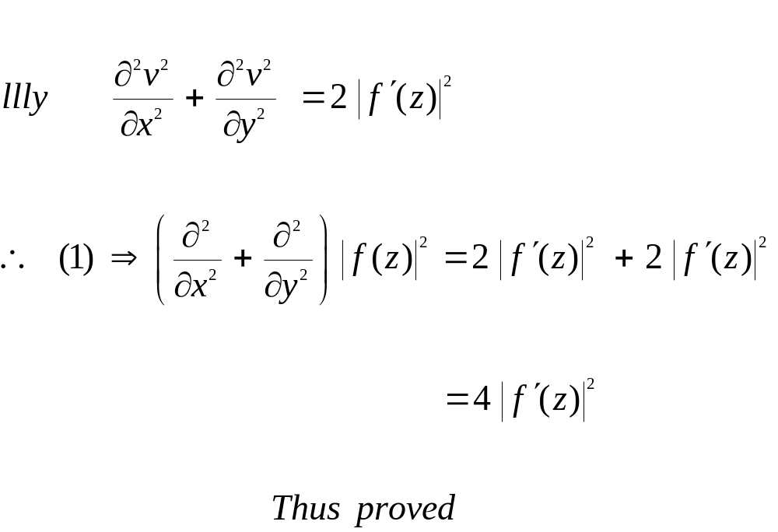
Properties of Analytic functions

Slide 47
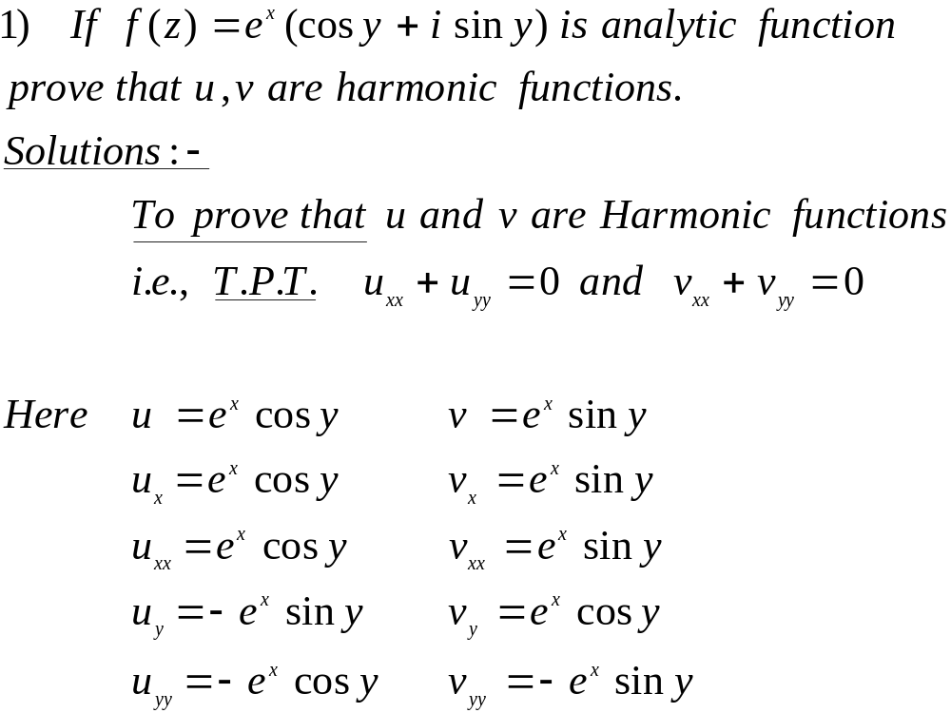
EXAMPLES

Slide 48
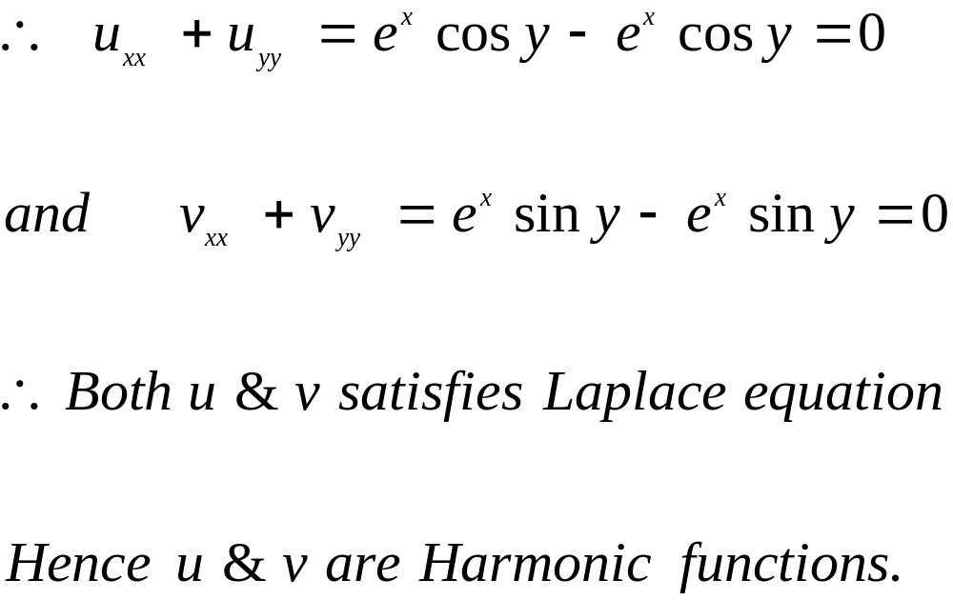
EXAMPLES

Slide 49
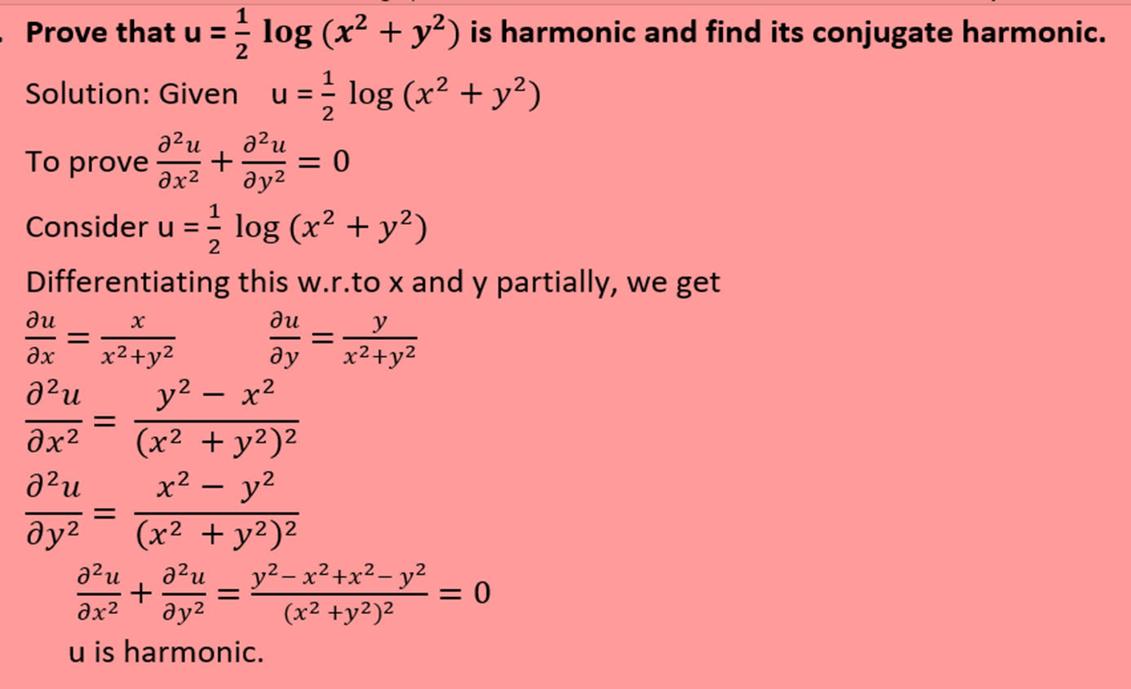
EXAMPLES

Slide 50

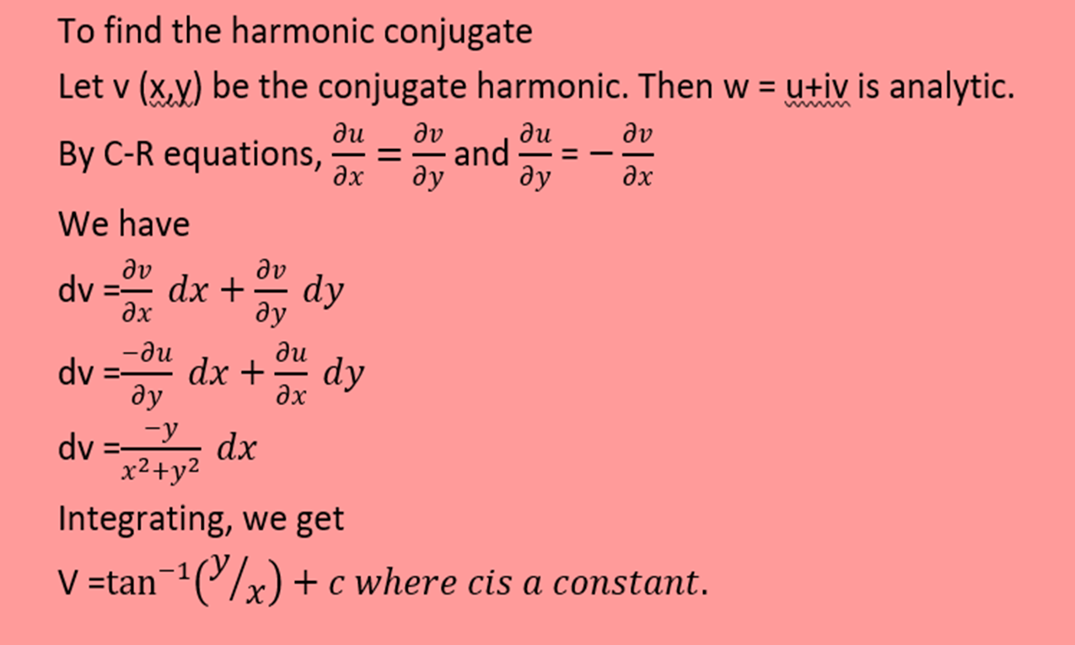
EXAMPLES

Slide 51
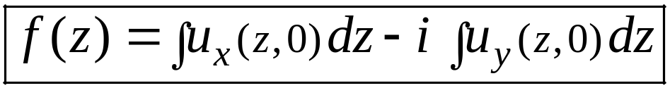
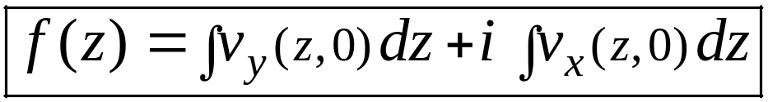
CONSTRUCTION OF ANALYTIC FUNCTION
MILNE-THOMSON METHOD :-
TO FIND THE ANALYTIC FUNCTION F(Z):
WHEN U(X , Y) IS GIVEN ( I.E., REAL PART IS GIVEN)
II) WHEN V(X ,Y ) IS GIVEN ( I.E., IMAGINARY PART IS GIVEN)

Slide 52
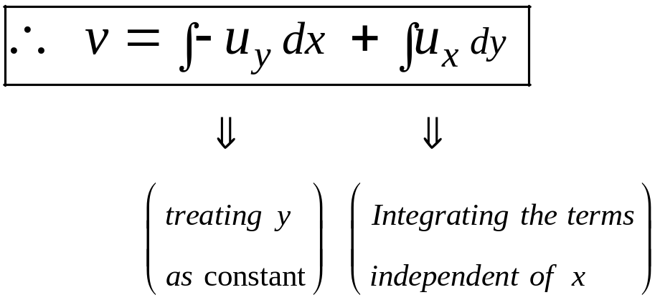
CONSTRUCTION OF ANALYTIC FUNCTION
METHOD TO FIND OUT THE HARMONIC CONJUGATE:
LET F(Z) = U + I V BE AN ANALYTIC FUNCTION.
GIVEN: U(X ,Y )

Slide 53
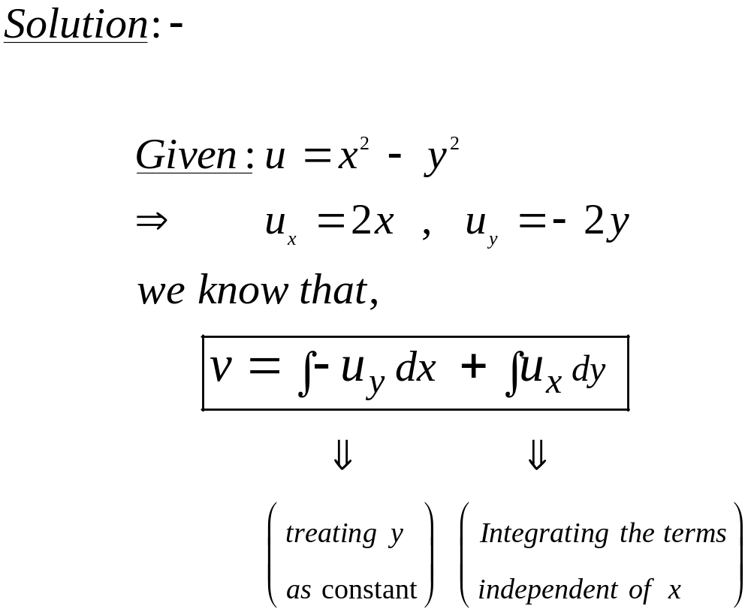
EXAMPLES
IF U(X ,Y ) = X² + Y² , FIND V(X ,Y ) AND HENCE FIND F(Z).

Slide 54

EXAMPLES

Slide 55

EXAMPLES
FIND F(Z), WHEN U(X ,Y ) = X² + Y² .
(SAME EXAMPLE, USING MILNE-THOMSON METHOD, FINDING F(Z) )

Slide 56

EXAMPLES
SHOW THAT THE FUNCTION U(X ,Y ) = SINX COSHY IS HARMONIC.
FIND ITS HARMONIC CONJUGATE V( X , Y ) AND THE ANALYTIC FUNCTION F(Z) =U + I V .

Slide 57

EXAMPLES

Slide 58

EXAMPLES

Slide 59

EXAMPLES
3) CONSTRUCT ANALYTIC FUNCTION F(Z) OF WHICH IMAGINARY PART V(X,Y) = - 2 SINX (E^{Y} - E^{-Y} ).

Slide 60

EXAMPLES
FIND THE ANALYTIC FUNCTION F(Z) = U+IV SUCH THAT,
U+V = X³ + 3X² Y - 3XY² - Y² + 4X + 5 AND F(0) = 2+3I .

Slide 61

EXAMPLES

Slide 62

EXAMPLES

Slide 63

EXAMPLES

Slide 64

EXAMPLES

Slide 65

EXAMPLES

Slide 66

EXAMPLES

Slide 67

EXAMPLES

Slide 68
CONFORMAL MAPPING
INTRO.: SUPPOSE TWO CURVES C₁ , C₂ IN THE Y C₁ C₂
Z-PLANE INTERSECT AT Z₀ AND THE CORRESPONDING Θ V ϒ₁ ϒ₂
CURVES ϒ₁ , ϒ₂ IN THE W-PLANE INTERSECT AT W₀ BY Z₀ W₀ Ο
THE TRANSFORMATION W= F(Z). X U
IF THE ANGLE BETWEEN THE TWO CURVES IN THE Z-PLANE IS SAME AS THE ANGLE BETWEEN THE CURVES IN THE W-PLANES BOTH IN MAGNITUDE AND IN DIRECTION, THEN THE TRANSFORMATION W = F(Z) IS SAID TO BE CONFORMAL MAPPING.
DEFINITION:-
A TRANSFORMATION THAT PRESERVES ANGLES BETWEEN EVERY PAIR OF CURVES THROUGH A POINT BOTH IN MAGNITUDE AND SENSE OF ROTATION IS SAID TO BE CONFORMAL AT THAT POINT.

Slide 69
CONFORMAL MAPPING
ISOGONAL TRANSFORMATION:-
THE TRANSFORMATION WHICH PRESERVES ANGLE BETWEEN EVERY PAIR OF CURVES IN MAGNITUDE AND NOT IN DIRECTION(SENSE) IS CALLED AN ISOGONAL TRANSFORMATION.
THEOREM:-
IF F(Z) IS ANALYTIC AND F'(Z)≠ 0 IN A REGION R OF THE Z-PLANE THEN THE MAPPING PERFORMED BY W=F(Z) IS CONFORMAL AT ALL POINTS OF R.

Slide 70

CONFORMAL MAPPING
CRITICAL POINTS:-
THE POINT AT WHICH THE MAPPING W=F(Z) IS NOT CONFORMAL, I.E., F ‘(Z) = 0 IS CALLED A CRITICAL POINT OF THE MAPPING.

Slide 71
Standard Transformations
TRANSLATION
MAPS OF THE FORM Z → Z + K, WHERE K Є C
MAGNIFICATION AND ROTATION
MAPS OF THE FORM Z → K Z , WHERE K Є C
INVERSION
MAPS OF THE FORM Z → 1 / Z

Slide 72
EXAMPLE FOR TRANSLATION
FIND THE REGION OF THE W-PLANE INTO WHICH THE RECTANGULAR
REGION IN THE Z-PLANE BOUNDED BY THE LINES X=0, Y=0, X=1, Y=2
IS MAPPED UNDER THE TRANSFORMATION W=Z+2-I .
SOLUTION:- GIVEN : W = Z + 2 - I
→ (U+IV) = (X+IY) + (2-I)
= (X+2) + I (Y-1)
EQUATING REAL AND IMAGINARY PARTS, WEGET,
U = X + 2 AND V = Y - 1

Slide 73
EXAMPLE FOR TRANSLATION
GIVEN BOUNDARY LINES ARE: TRANSFORMAL BOUNDARY LINES ARE:
X = 0 U = 2
Y = 0 V = -1
X = 1 U = 3
Y = 2 V = 1
V
Y V = 1
Y = 2 U=2 U = 3
0 U
X = 0 X = 1
V = -1
0 Y = 0 X

Slide 74
MAGNIFICATION AND ROTATION
LET W = A Z, WHERE A ≠ 0
IF A = │A│ E^(I Α) AND, Z = │Z │ E^(I Θ), THEN
W = │A│ │Z│ E^I(Θ + Α )
THE IMAGE OF Z IS OBTAINED BY ROTATING THE VECTOR Z THROUGH THE ANGLE Α AND MAGNIFYING OR CONTRACTING THE LENGTH OF Z BY THE FACTOR │A│.
THUS THE TRANSFORMATION W = A Z IS REFERRED TO AS A ROTATION OR MAGNIFICATION.

Slide 75
EXAMPLE FOR MAGNIFICATION
2) DETERMINE THE REGION R OF THE W PLANE INTO WHICH THE TRIANGULAR REGION D ENCLOSED BY THE LINES X = 0, Y = 0, X + Y = 3 IS TRANSFORMED UNDER THE TRANSFORMATION W = 2Z.
SOLUTION:
LET W = U +I V ; Z = X + I Y
GIVEN: W = 2 Z
I.E., U +I V = 2 (X + I Y)
I.E., U = 2 X ; V = 2 Y AND U+V = 2(X+Y)

Slide 76

EXAMPLE FOR MAGNIFICATION
WHEN X = 0 , U = 0
Y = 0 , V = 0
X + Y = 3 , U + V = 6
THUS THE TRANSFORMATION W = 2Z MAPS A TRIANGLE IN THE Z-PLANE INTO A 2-TIMES MAGNIFIED TRIANGLE IN THE W-PLANE.

Slide 77

EXAMPLE FOR ROTATION
CONSIDER THE TRANSFORMATION W = E^{IΠ/4} Z AND DETERMINE THE REGION IN THE W-PLANE CORRESPONDING TO TRIANGLE REGION BOUNDED BY THE LINES X=0 , Y=0 , X+Y=1.

Slide 78


EXAMPLE FOR ROTATION
Y
X=0 X+Y=1
0 Y=0 X
V
V = 1/
U=-V U=V
Π/4 U
0

Slide 79


EXAMPLE FOR ROTATION
THE REGION IN THE Z-PLANE IS MAPPED ON TO THE REGION BOUNDED BY U = -V, U = V, IN THE W-PLANE.

Slide 80




INVERSE TRANSFORMATION
THE RECIPROCAL TRANSFORMATION W = 1/Z
THE MAPPING IS CALLED THE RECIPROCAL TRANSFORMATION AND MAPS THE Z-PLANE ONE-TO-ONE AND ONTO THE W-PLANE EXCEPT FOR THE POINT Z=0, WHICH HAS NO IMAGE, AND THE POINT W=0, WHICH HAS NO PREIMAGE OR INVERSE IMAGE. USE THE EXPONENTIAL NOTATION IN THE W-PLANE. IF , WE HAVE .
.

Slide 81


INVERSE TRANSFORMATION
THE GEOMETRIC DESCRIPTION OF THE RECIPROCAL TRANSFORMATION IS NOW EVIDENT. IT IS AN INVERSION (THAT IS, THE MODULUS OF ( ) IS THE RECIPROCAL OF THE MODULUS OF Z) FOLLOWED BY A REFLECTION THROUGH THE X AXIS. THE RAY , IS MAPPED ONE-TO-ONE AND ONTO THE RAY . POINTS THAT LIE INSIDE THE UNIT CIRCLE ARE MAPPED ONTO POINTS THAT LIE OUTSIDE THE UNIT CIRCLE AND VICE VERSA. THE SITUATION IS ILLUSTRATED IN FIGURE.

Slide 82

INVERSE TRANSFORMATION

Slide 83





EXAMPLE OF INVERSE TRANSFORMATION
1) SHOW THAT THE IMAGE OF THE RIGHT HALF PLANE UNDER THE MAPPING IS THE CLOSED DISK
IN THE W-PLANE.
SOLUTION:-
THEN,

Slide 84

EXAMPLE OF INVERSE TRANSFORMATION

Slide 85


EXAMPLE OF INVERSE TRANSFORMATION
WHICH DESCRIBES THE DISK. AS THE RECIPROCAL TRANSFORMATION IS ONE-TO-ONE, PREIMAGES OF THE POINTS IN THE DISK WILL LIE IN THE RIGHT HALF-PLANE . FIGURE ILLUSTRATES THIS RESULT.

Slide 86


EXAMPLE OF INVERSE TRANSFORMATION
2) FIND THE IMAGES OF THE FINITE STRIPS,

Slide 87

EXAMPLE OF INVERSE TRANSFORMATION

Slide 88

EXAMPLE OF INVERSE TRANSFORMATION
V
Y U
Y = ½
Y = ¼
0 X

Slide 89

BILINEAR TRANSFORMATION

Slide 90

BILINEAR TRANSFORMATION
FIXED POINTS (OR) INVARIANT POINTS :-
IF THE IMAGE OF A POINT Z UNDER A TRANSFORMATION W=F(Z) IS ITSELF, THEN THE POINT IS CALLED A FIXED POINT OR AN INVARIANT POINT OF THE TRANSFORMATION.
THUS FIXED POINT OF THE TRANSFORMATION W=F(Z) IS GIVEN BY Z = F(Z).

Slide 91

BILINEAR TRANSFORMATION

Slide 92

BILINEAR TRANSFORMATION
NOTE:-
THE BILINEAR TRANSFORMATION WHICH TRANSFORMS THE POINTS
Z ₁ , Z₂ , Z₃ OF Z-PLANE RESPECTIVELY INTO THE POINTS W ₁,W₂ ,W₃ OF
W-PLANE IS GIVEN BY

Slide 93

BILINEAR TRANSFORMATION
EXAMPLES

Slide 94

BILINEAR TRANSFORMATION
EXAMPLES

Slide 95

BILINEAR TRANSFORMATION
EXAMPLES

Slide 96

BILINEAR TRANSFORMATION
EXAMPLES

Slide 97

BILINEAR TRANSFORMATION
TRY IT
FIND THE BILINEAR TRANSFORMATION WHICH MAPS THE POINTS,
I) 1, -I , 2 ONTO 0, 2, I RESPECTIVELY.
II) -I,0,I INTO -1, I, 1 RESPECTIVELY.
III) 0, 1, INTO I, -1, -I RESPECTIVELY.

Slide 98


